Slide 1

Capstone Project - A 'New-style' Classical Music Festival
Applied Data Science Capstone by Coursera/IBM

Slide 2
INTRODUCTION
Business Problem

Slide 3
Introduction
The benefits of listening to classical music are endless. It can:
improve your mood
lower stress levels
increase productivity
spark creativity
boost brain power
However, classical music has a diversity problem. It is far too white and far too inaccessible to a lot of people. More needs to be done to take classical music out of the traditional concert hall and brought to a much wider range of communities, to make it more accessible to all, and to break down the barriers and stereotypes surrounding the genre.

Slide 4
Continued…
Through combining demographic data collected by Greater London Authority in 2016, and Foursquare location data, this project aims to highlight potential areas and venues in London that could host a:
‘New-style’ Classical Music Festival
It should appeal to any philanthropist wanting to increase the outreach of classical music.

Slide 5
DATA

Slide 6
Data
Kaggle data set on London Boroughs from study conducted by GLA in 2016 which can be found here.
Geopy library to get the latitude and longitude values of London Boroughs
Foursquare API to get location and venue data for potential concert venues

Slide 7
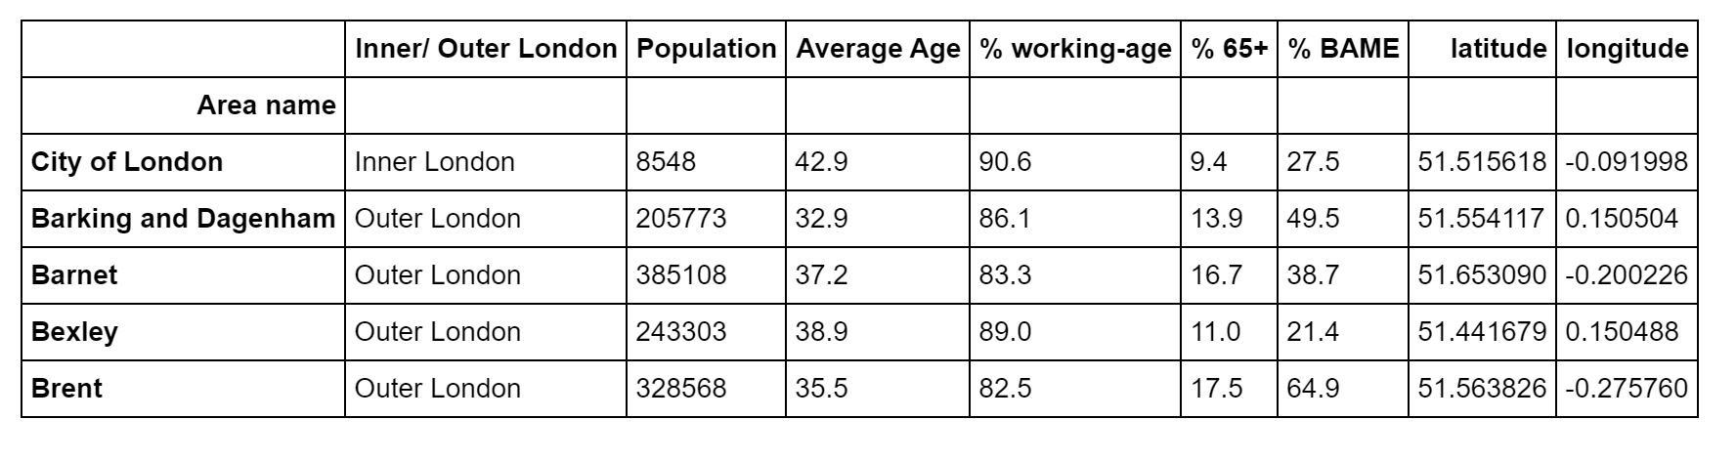
Cleaned Data Frame with Location data added:

Slide 8
METHODOLOGY

Slide 9
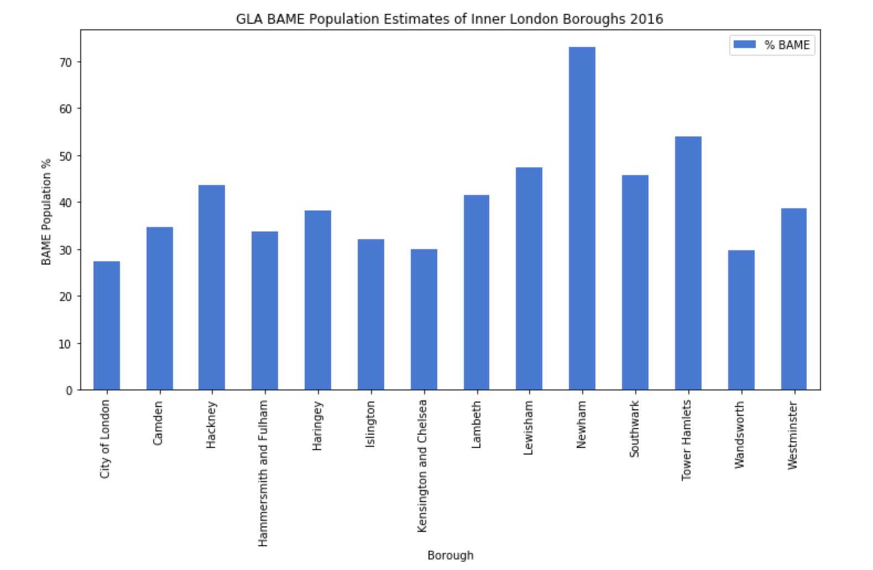
GLA BAME Population Estimates of Inner London Boroughs 2016

Slide 10
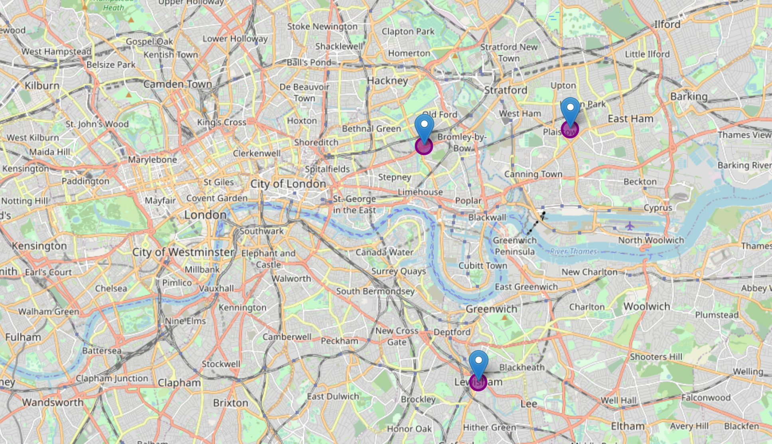
Top 3 Inner London Boroughs with highest BAME population
1. Newham
2. Towers Hamlet
3. Lewisham

Slide 11

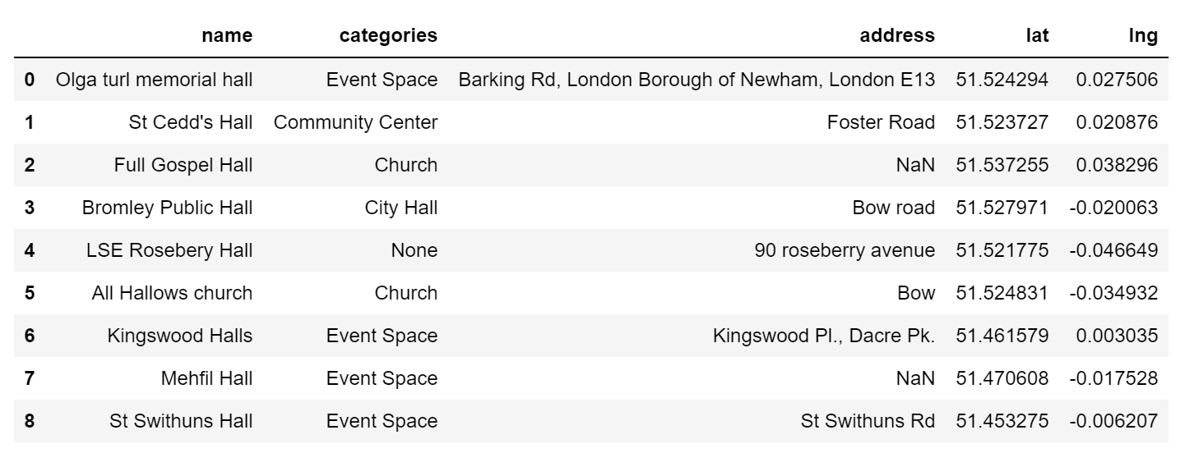
Foursquare Search Results

Slide 12
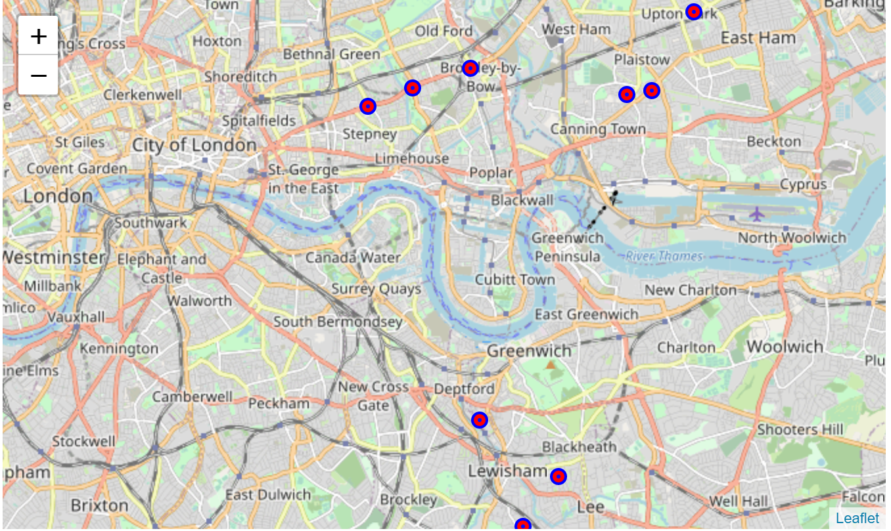
Locations added to Map

Slide 13
RESULTS

Slide 14
Possible Venues for ‘A New-Style Classicl Music Festival’:
Olga turl memorial hall, Newham
St Cedd's Hall, Newham
Full Gospel Hall, Newham
Bromley Public Hall, Tower Hamlets
LSE Rosebery Hall, Tower Hamlets
All Hallows church, Tower Hamlets
Kingswood Halls, Lewisham
Mehfil Hall, Lewisham
St Swithuns Hall, Lewisham

Slide 15
Discussion & conclusion

Slide 16
The results of this project provide a great starting point to finding a venue for a ‘New-Style Classical Music Concert’.
However, there is lots of information needed when making a decision on a concert venue that is not provided by foursquare. For example:
Size
Audience Capacity
Local amenities such as:
Pubs/bars/restaurants
Further research could include site visits as the next step to get answers to the above.
Further analysis could also be done on the demographic data to take into account features such as age and household income, to determine whether a festival in the area would be successful or not.

Slide 17
Thank you
Applied Data Science Capstone by Coursera/IBM

